Slide 1

Sakshi Ghodeswar - Namma Yatri: Power BI Dashboard Insights
A data-driven review of ride performance, demand patterns, and strategic opportunities — built for leadership decision-making.
Q3 2024 ANALYSIS
POWER BI DASHBOARD

Slide 2

Performance at a Glance
2,161
983
Total Searches
Completed Rides
Ride requests initiated across all zones in the review period
Successfully fulfilled trips — our primary revenue driver
45.49%
₹751K
Conversion Rate
Total Revenue
Proportion of searches that resulted in completed rides
Gross revenue generated across all completed trips
Key Insight: With 2,161 searches but only 983 completions, over half the potential demand is lost before a ride is fulfilled — a significant revenue gap to address.

Slide 3
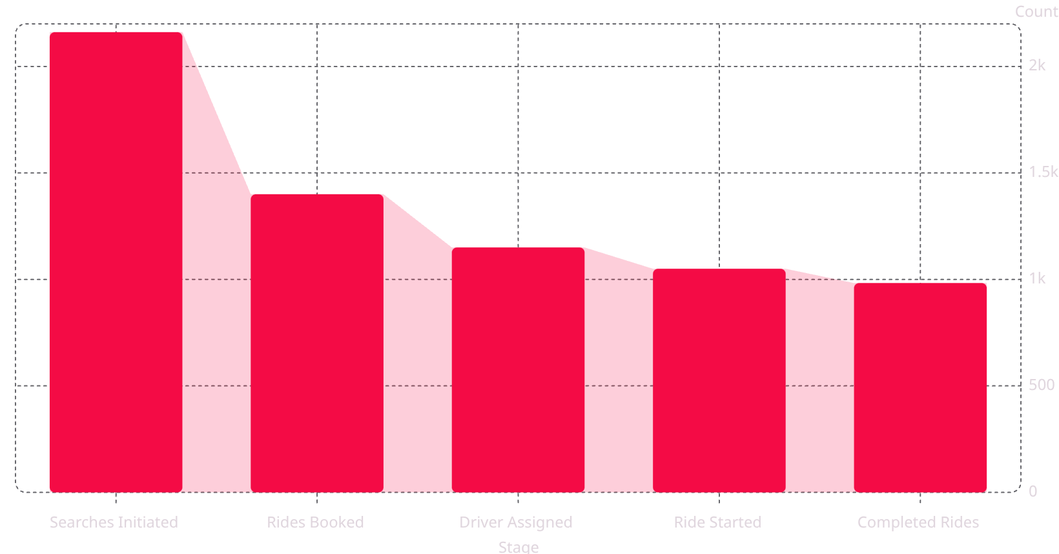

The Ride Conversion Funnel
45.49%
Where Demand Drops Off
Total conversion rate
The funnel reveals critical leakage points between search and completion.
35% drop between search and booking — users abandon before confirming
18% drop between booking and driver assignment — supply gap
6% drop post-assignment — cancellations and no-shows
Key Insight: The largest drop-off occurs before booking — pricing transparency and wait-time estimates are likely friction points.

Slide 4
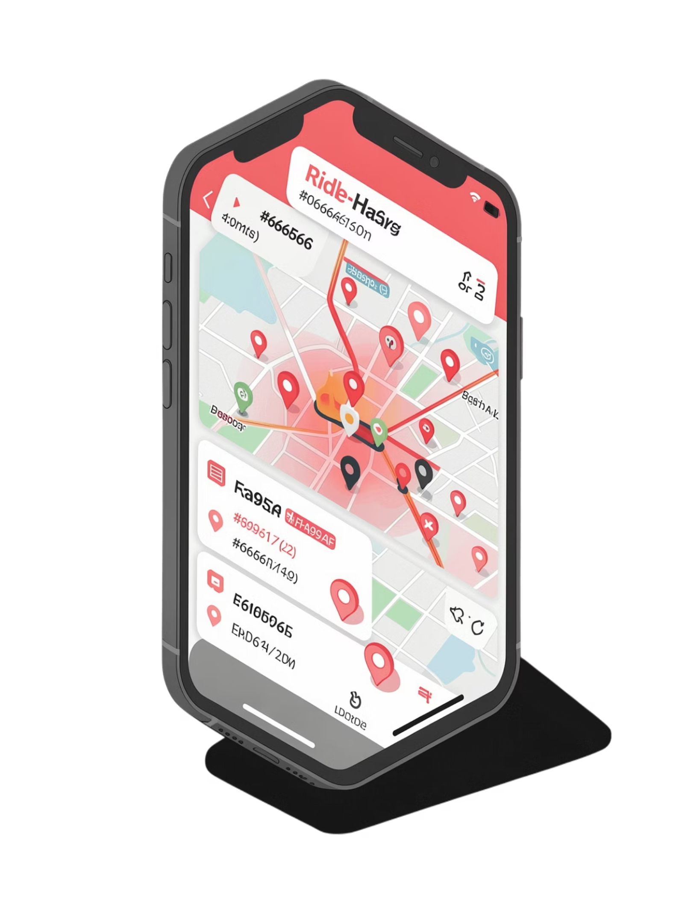

Demand Trends: When Riders Need Us Most
Peak Hours
Morning (8–10 AM) and evening (6–9 PM) commutes account for ~62% of all searches — align driver incentives to these windows.
Weekday vs Weekend
Weekday searches outpace weekends by 3:1, reflecting commuter-dominated demand. Weekend evenings show a secondary leisure-ride spike.
Seasonal Pattern
Search volume rises ~18% during rainy days — an opportunity for surge pricing and proactive driver deployment.
Key Insight: Concentrating driver supply during peak windows could improve assignment rates and reduce the 18% booking-to-assignment drop-off.

Slide 5
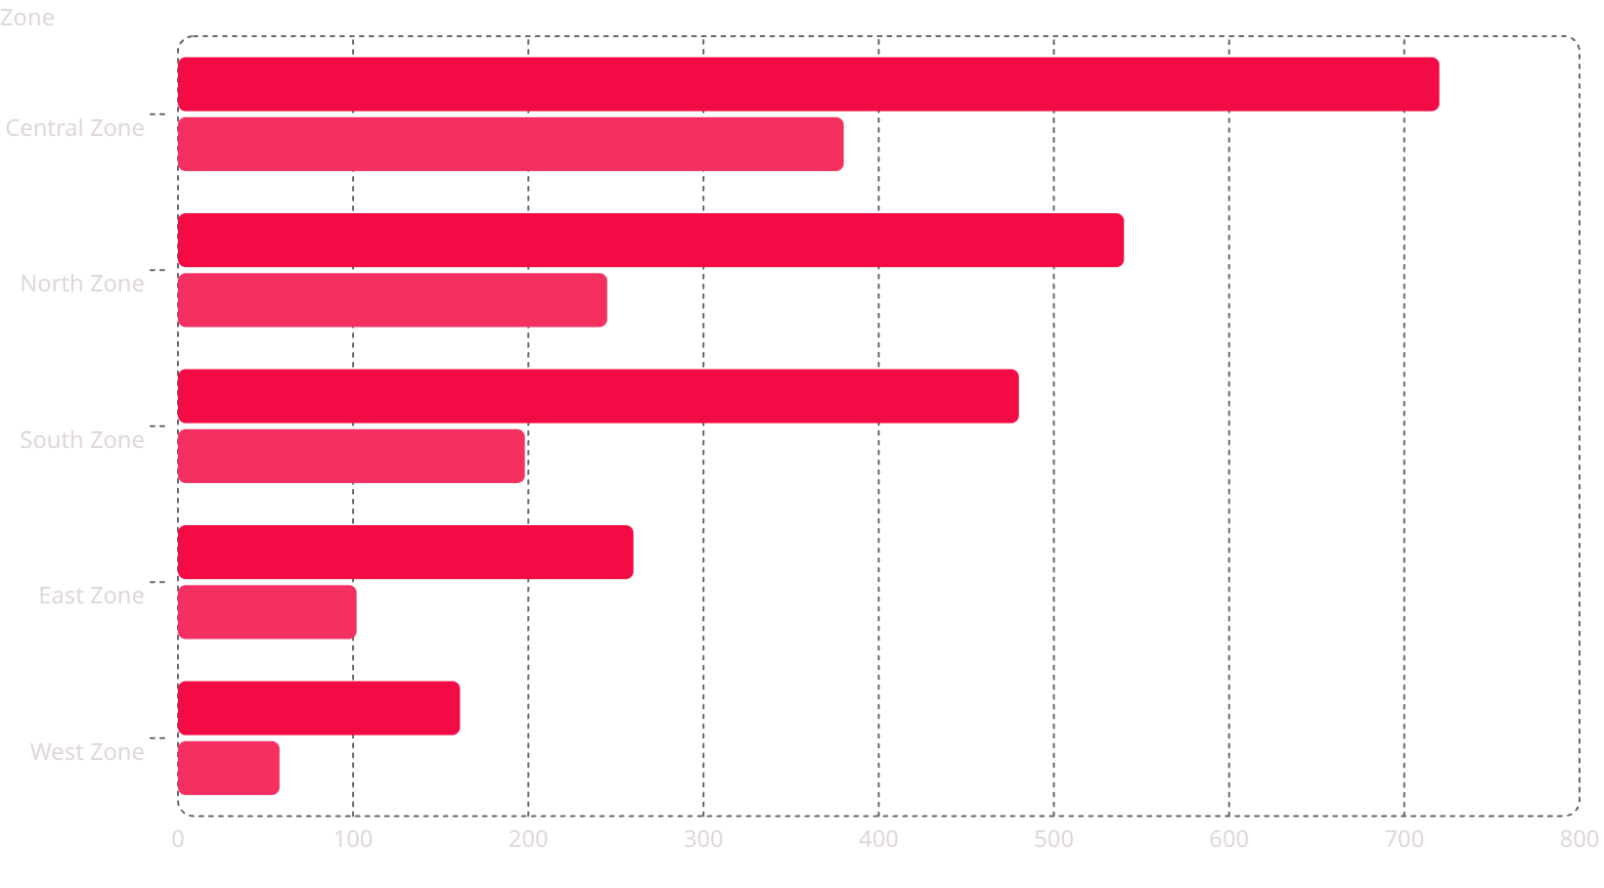
Zone Performance Breakdown
Searches
Completed Rides
Central Zone Leads — But Gaps Persist
Central Zone generates 33% of all searches and 39% of completions — the highest conversion at ~53%.
West Zone has the lowest conversion (~36%) — driver scarcity is the likely cause
South Zone shows high search volume but poor completion — investigate wait times
North Zone is under-served relative to its search demand
Key Insight: Redistributing 15–20% of Central Zone drivers to West and South zones could lift overall conversion by 5–8 points.

Slide 6


Cancellations: The Hidden Revenue Leak
What's Driving Cancellations?
Of the 1,178 uncompleted searches, an estimated ~15–18% result in cancellations — directly eroding revenue.
Driver No-Show·38%
·38%
·
Driver no-shows (38%) — the single largest cause; points to reliability and accountability gaps
Rider-initiated cancels (29%) — often triggered by long ETA or better alternatives
Wait time (18%) — a solvable supply-allocation problem
Rider Cancelled·29%
·29%
·
Long Wait Time·18%
·18%
·
Technical Issues·9%
·9%
·
Other·6%
·6%
·
Key Insight: Reducing driver no-shows by just 10 points could recover an estimated ₹40–50K in monthly revenue.

Slide 7

Revenue Per Ride: Efficiency Metrics
₹764 Avg. Fare
₹347 Per Search
₹1.16K Lost Per Day
Revenue per completed ride (₹751K ÷ 983 rides). Benchmark against competitor pricing to assess positioning.
Revenue potential per search initiated. At 100% conversion, total addressable revenue would be ~₹1.65M — nearly 2.2× current performance.
Estimated daily revenue loss from unconverted searches (based on avg. fare × uncompleted rides ÷ review period days).
Key Insight: Every 1-point improvement in conversion rate translates to approximately ₹7.6K additional revenue — a clear ROI case for funnel optimization.

Slide 8


Power BI Dashboard: Key Views
Overview Page
High-level KPIs — searches, completions, conversion rate, and total revenue — with period-over-period comparison.
Funnel Analysis
Step-by-step drop-off visualization from search to completion, filterable by zone, time, and driver category.
Zone Map View
Geospatial heatmap of search density vs. completion rates — identifies under-served areas at a glance.
Time Trends
Hourly and daily demand patterns with cancellation overlays — essential for driver scheduling decisions.

Slide 9
Strategic Recommendations
1
Close the Booking Gap
2
Rebalance Zone Supply
Reduce pre-booking drop-off with upfront fare estimates and live driver availability indicators on the search screen.
Deploy incentive zones in West and South areas during peak hours to improve driver-to-search ratios and lift conversion.
3
Tackle Driver No-Shows
4
Automate Weekly Reporting
Introduce a driver reliability score with consequences for repeated no-shows; pilot a pre-ride confirmation step.
Schedule Power BI dashboard snapshots to leadership every Monday — turning data into a standing operating rhythm.
Key Insight: Implementing all four recommendations could realistically push conversion from 45.5% → 60%+, unlocking an additional ₹250–300K in monthly revenue.

Slide 10


Next Steps & Ownership
1
Week 1–2
Operations team to review zone-level driver allocation; implement peak-hour incentives in West and South zones.
2
Week 3–4
Product team to prototype fare transparency features; A/B test on 10% of user traffic.
3
Month 2
Launch driver reliability scoring pilot; integrate no-show tracking into Power BI dashboard.
4
Month 3
Full leadership review — measure conversion lift, revenue impact, and iterate on recommendations.
Target: Achieve 55%+ conversion rate and ₹900K+ monthly revenue within 90 days — a 20%+ improvement on current performance.

